Slide 1



Atwood Lab Figures

Slide 2
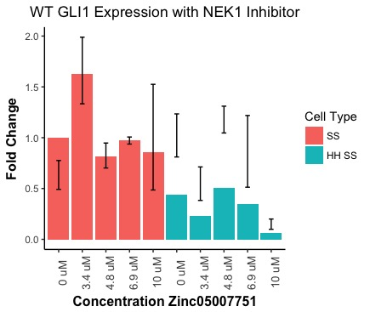
Gli Expression 3T3 NEK1 Inhibitor
NEEDS TO BE RERUN Because normalization for SE is odd!

Slide 3
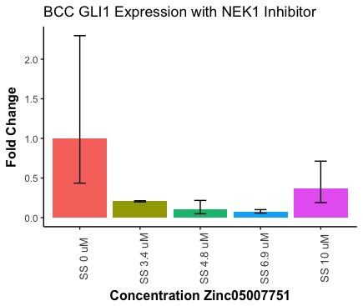
GLI Expression BCC NEK1 Inhibitor
NEEDS TO BE RERUN BECAUSE OF SD OF 0uM

Slide 4
MTT Assay Zinc (Absorbance)

Slide 5
MTT Assay Zinc (Percent Viability)

Slide 6
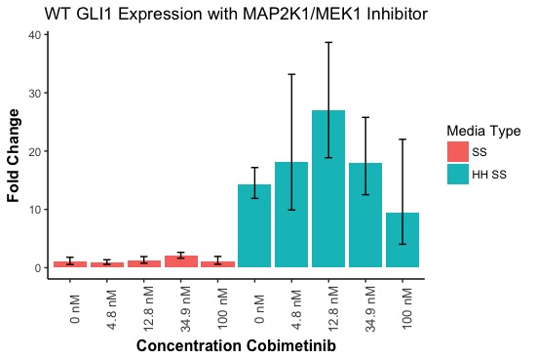
GLI Expression 3T3 MEK Inhibitor Cobi
Notes:
Should this be cell type or mediacondition?

Slide 7
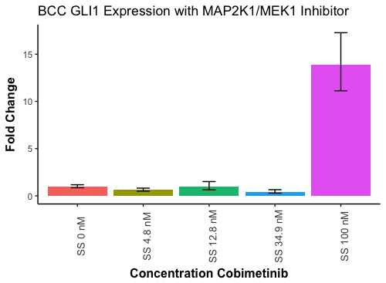
GLI Expression BCC MEK Inhibitor Cobi

Slide 8
MTT Assay Cobimetinib (Absorbance)

Slide 9
MTT Assay Cobimetinib (Percent Viability)

Slide 10
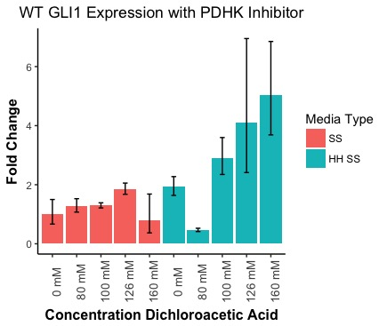
GLI Expression 3T3 PDHK Inhibitor DCAA

Slide 11
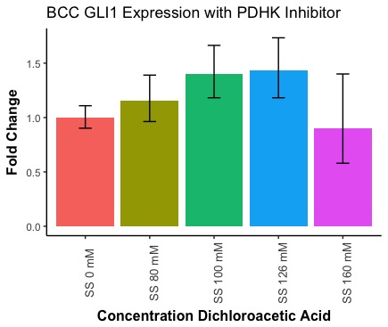
GLI Expression BCC PDHK Inhibitor DCAA

Slide 12
MTT Assay DCAA (Absorbance)

Slide 13
MTT Assay DCAA (Percent Viability)

Slide 14
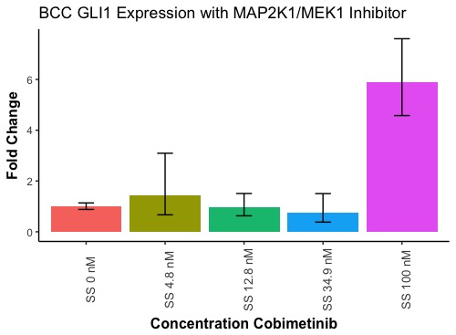
A..
B..
Figure 1: Inhibition of MAP2K1/MEK1 by Cobimetinib does not impact Hedgehog Signaling.
A. GLI1 expression of Wild Type 3T3 Cells grown in serum starved media (SS) or serum starved with Hedgehog conditioned media (HH SS) in the presence of Cobimetinib at varying concentrations. Expression of GLI1 is normalized based on expression of housekeeping gene GAPDH. Standard error bar corresponds to technical replicates.
B. GLI1 expression of Basal Cell Carcinoma (BCC) cells grown in serum starved media (SS) in the presence of Cobimetinib at varying concentrations. Expression of GLI1 is normalized based on expression of housekeeping gene GAPDH. Standard error bar corresponds to technical replicates.

Slide 15
Figure 2: Treatment of BCC cells with MAP2K1/MEK1 inhibitor Cobimetinib does not impact cell viability. Measurement of the absorbance at 570 nM as a means of determining cell viability through an MTT assay. BCC cells were treated with increasing concentrations of inhibitor drug over the course of 6 days. Error bars represent the standard deviation of technical replicates.

Slide 16
A..
B..
Figure 3: Inhibition of PDHK by Dichloroacetic Acid does not impact Hedgehog Signaling.
A. GLI1 expression of Wild Type 3T3 Cells grown in serum starved media (SS) or serum starved with Hedgehog conditioned media (HH SS) in the presence of Dichloroacetic acid at varying concentrations. Expression of GLI1 is normalized based on expression of housekeeping gene GAPDH. Standard error bar corresponds to technical replicates.
B. GLI1 expression of Basal Cell Carcinoma (BCC) cells grown in serum starved media (SS) in the presence of Dichloroacetic acid at varying concentrations. Expression of GLI1 is normalized based on expression of housekeeping gene GAPDH. Standard error bar corresponds to technical replicates.

Slide 17
Figure 4: Treatment of BCC cells with PDHK inhibitor Dichloroacetic Acid does not affect cell survival. Measurement of the absorbance at 570 nM as a means of determining cell viability through an MTT assay. BCC cells were treated with increasing concentrations of inhibitor drug Dichloroacetic Acid over the course of 6 days. Error bars represent the standard deviation of technical replicates.

Slide 18
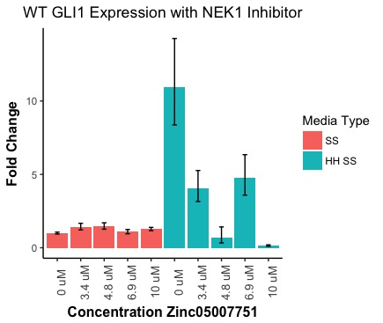
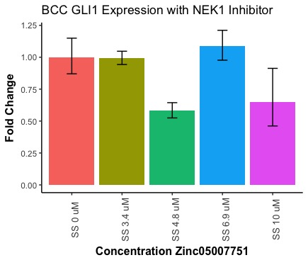
A..
B..
Figure 5: Inhibition of NEK1 by Zinc05007751 reduces Hedgehog Signaling activation.
A. GLI1 expression of Wild Type 3T3 Cells grown in serum starved media (SS) or serum starved with Hedgehog conditioned media (HH SS) in the presence of Zinc05007751 at varying concentrations. Expression of GLI1 is normalized based on expression of housekeeping gene GAPDH. Standard error bar corresponds to technical replicates.
B. GLI1 expression of Basal Cell Carcinoma (BCC) cells grown in serum starved media (SS) in the presence of Zinc05007751 at varying concentrations. Expression of GLI1 is normalized based on expression of housekeeping gene GAPDH. Standard error bar corresponds to technical replicates.

Slide 19
Figure 6: Treatment of BCC cells with NEK1 Inhibitor Zinc05007751does not affect cell survival. Measurement of the absorbance at 570 nM as a means of determining cell viability through an MTT assay. BCC cells were treated with increasing concentrations of inhibitor drug Zinc05007751 for 6 days. Error bars represent the standard deviation of technical replicates. over the course of 6 days.

